Slide 1
CS F372 Operating Systems
12 – Deadlocks introduction

Slide 2
Text Book Reading
Chapter 7
Sections 7.1, 7.2. 7.3

Slide 3
Deadlocks
In a multiprogramming environment:
The system has different categories of resources
The number of resources in each category is limited
Process requests resources
If resources are not available, process waits
If the requested resources are held by other waiting processes, process continues to wait forever
Situation is deadlock

Slide 4
Deadlock and examples
A set of blocked processes each holding a resource and waiting to acquire a resource held by another process in the set.
Example 1
System has 2 tape drives
P₁ and P₂ each hold one tape drive and each needs another one
Example 2
semaphores A and B, initialized to 1
P₀ P₁
wait (A); wait(B);
wait (B); wait(A);

Slide 5
Example of Deadlock
Space is available for allocation of 200K bytes, and the following sequence of events occur
Deadlock occurs if both processes progress to their second request
P1
. . .
. . .
P2
Request 80K bytes;
Request 70K bytes;
. . .
. . .
Request 60K bytes;
Request 80K bytes;

Slide 6
Resource classification
Preemptable resource:
Can be taken away from the process owning it
Primary memory is a preemptable resource
Consider a system with 512K of user memory, one printer and two 512K processes A and B
Process A requests and gets the printer
Starts to compute the values to print
Before it finished with the computation it exceeds its time quantum and is swapped out
Process B now runs and tries unsucessfully to acquire the printer
Potentially a dead lock ( A has the printer B has the memory )
It is possible to preempt the memory from B and swap it to secondary storage thus moving the process A to main memory

Slide 7
Resource classification
Non-preemptable resource
Can not be taken away from its current owner without causing the computation to fail
If a process has begun to print output, taking the printer away from it and giving to another process will result in chaos
Printers are not preemptable
In dead locks we will deal with nonpreemptable resources

Slide 8
System model
Finite number of resources, distributed among competing processes
Resource types R₁, R₂, ..., R_{m}
CPU cycles, memory space, I/O devices, printers, tape drives, CD ROMS, database record
Each resource type R_{i} may have some number of instances
Printer may have 5 instances
Each process utilizes a resource as follows:
Request
Use
Release

Slide 9
System model
Request - If the request cannot be immediately granted, then the process must wait until the resource(s) it needs become available. For example the system calls open( ), malloc( )
Use - The process uses the resource, e.g. prints to the printer or reads from the file
Release - The process relinquishes the resource so that it becomes available for other processes. For example, close( ), free( ), delete( )

Slide 10
System model
A system table (maintained by kernel)
Records whether a resource is free or allocated
If a resource is allocated, to which process
If a process requests a resource currently allocated to another process
Process added to a queue of processes waiting for that resource

Slide 11
Deadlock characterization
Necessary conditions
Deadlock can arise if four conditions hold simultaneously
Mutual exclusion: At least one resource must be held in a nonsharable mode; that is, only one process at a time can use the resource. If another process requests that resource, the requesting process must be delayed until the resource has been released.
Hold and wait: A process must be holding at least one resource and waiting to acquire additional resources that are currently being held by other processes

Slide 12
Deadlock characterization
Necessary conditions
Deadlock can arise if four conditions hold simultaneously
No preemption: Resources cannot be preempted; that is, a resource can be released only voluntarily by the process holding it, after that process has completed its task.
Circular wait: There exists a set {P₀, P₁, …, P_{n}} of waiting processes such that P₀ is waiting for a resource that is held by P₁, P₁ is waiting for a resource that is held by P₂, …, P_{n–1} is waiting for a resource that is held by P_{n}, and P_{n} is waiting for a resource that is held by P₀.

Slide 13
Resource allocation graph (RAG)
RAG describes deadlock
Directed graph used to describe deadlock
A set of vertices V and a set of edges E
V is partitioned into two types:
P = {P₁, P₂, …, P_{n}}, the set consisting of all the processes in the system.
R = {R₁, R₂, …, R_{m}}, the set consisting of all resource types in the system.

Slide 14
Resource allocation graph
E is partitioned into two types:
request edge – directed edge
P_{i} → R_{j}
indicating that process Pi has requested Rj, and is currently waiting for that resource to become available
assignment edge – directed edge
R_{j} → P_{i}
indicating that resource Rj has been allocated to process Pi, and that Pi is currently holding resource Rj

Slide 15
Resource allocation graph
Process
Resource Type with 4 instances
P_{i} requests instance of R_{j}
P_{i} is holding an instance of R_{j}
P_{i}
R_{j}
P_{i}

Slide 16
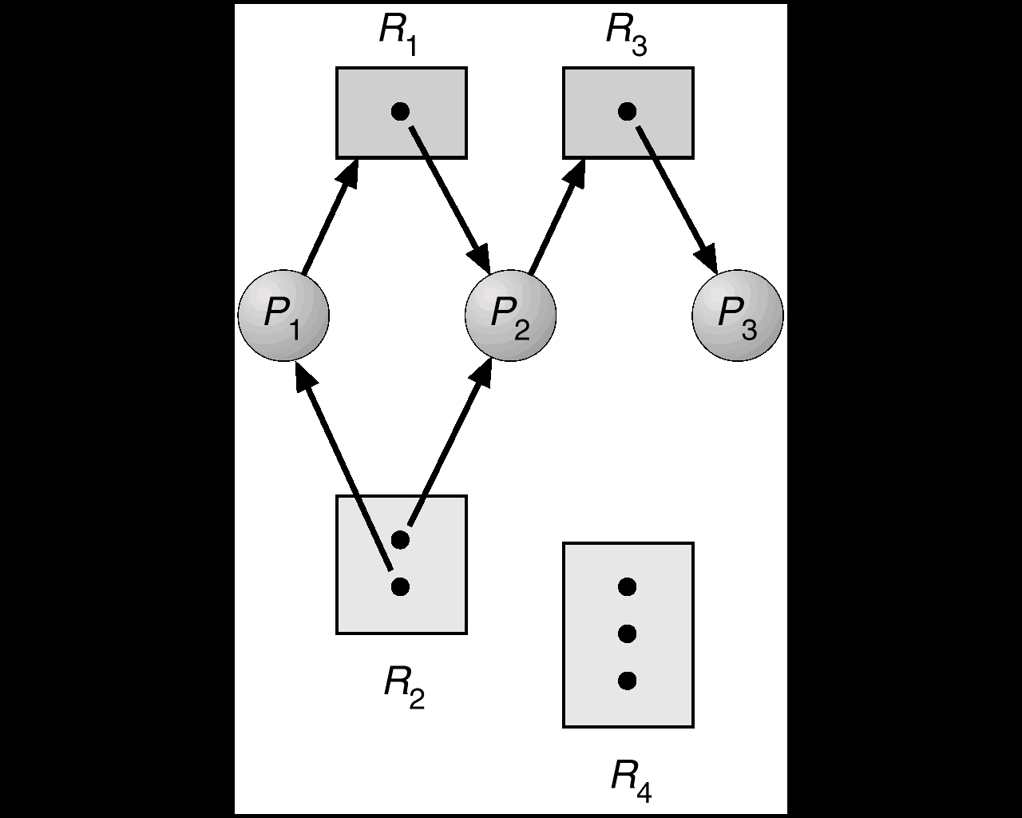
Resource allocation graph- example
The sets P, R, and E:
◦ P = {P1, P2, P3}
◦ R = {R1, R2, R3, R4}
◦ E = {P1 → R1, P2 → R3, R1 → P2, R2 → P2, R2 → P1, R3 → P3}

Slide 17
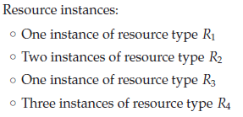
Resource allocation graph- example

Slide 18
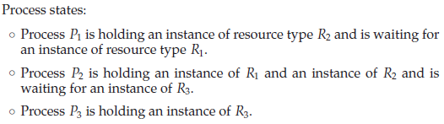
Resource allocation graph- example

Slide 19
Resource allocation graph and deadlock
Given a RAG it can be shown that:
If resource-allocation graph contains no cycles, no process is deadlocked
If resource-allocation graph contains cycles, deadlock may exist
If only one instance of each resource type and a cycle, there is a deadlock (In this case, a cycle in the graph is both a necessary and a sufficient condition for the existence of deadlock)
If each resource type has several instances, then a cycle does not necessarily imply that a deadlock has occurred (In this case, a cycle in the graph is a necessary but not a sufficient condition for the existence of deadlock)

Slide 20

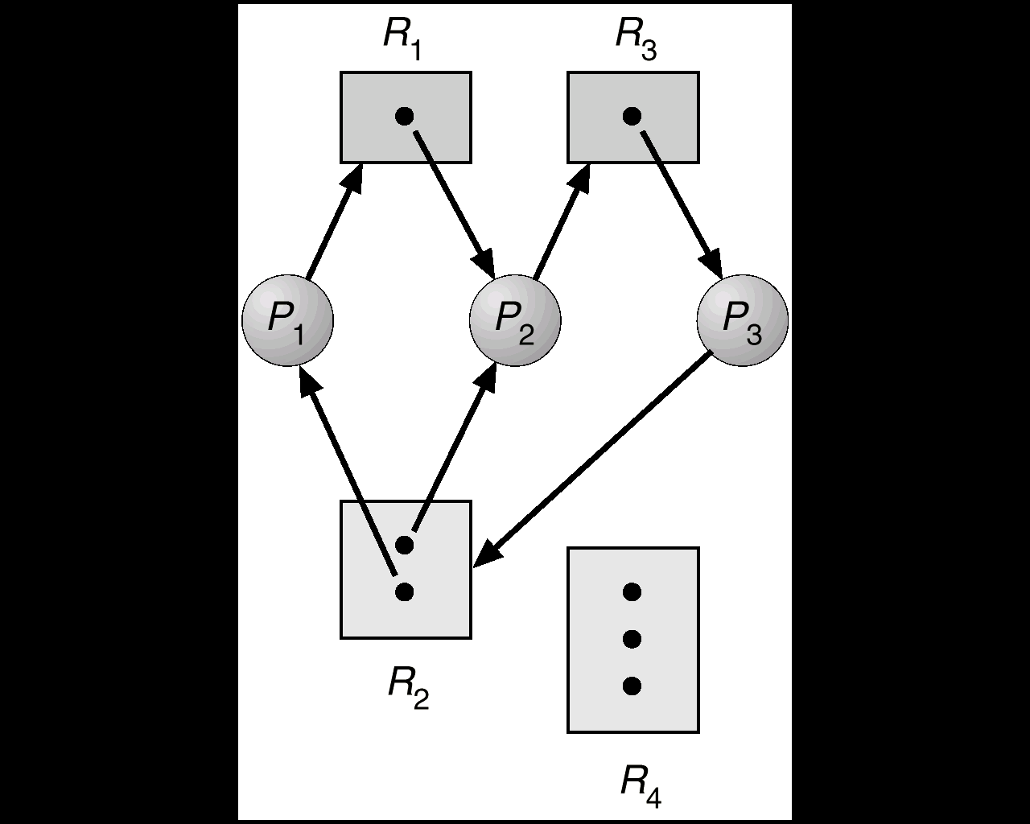
Resource allocation graph with deadlock
Suppose that process P3 requests an instance of resource type R2
Processes P1, P2, and P3 are deadlocked. Process P2 is waiting for the resource R3, which is held by process P3. Process P3 is waiting for either process P1 or process P2 to release resource R2. In addition, process P1 is waiting for process
P2 to release resource R1

Slide 21
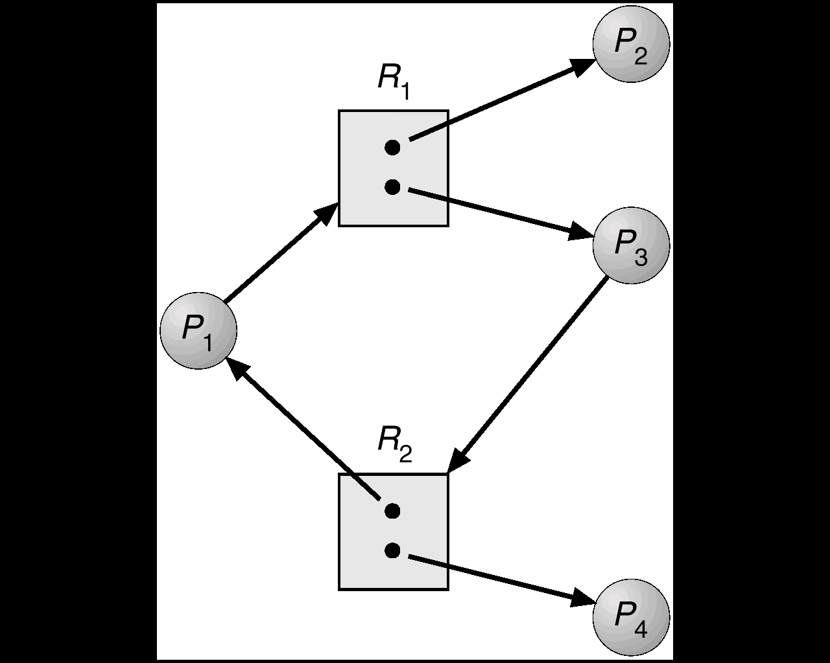
Resource allocation graph with cycle but no deadlock

Slide 22
If graph contains no cycles ⇒ no deadlock.
If graph contains a cycle ⇒
if only one instance per resource type, then deadlock.
if several instances per resource type, possibility of deadlock.
.

Slide 23
Methods for handling deadlock
Ensure that the system will never enter a deadlock state by using a protocol to prevent or avoid deadlock
Allow the system to enter a deadlock state, detect and then recover
Ignore the problem and pretend that deadlocks never occur in the system; used by most operating systems, including UNIX.

Slide 24
Methods for handling deadlock
Deadlock Prevention
Methods ensuring that at least one of the necessary conditions does not hold
Deadlock Avoidance
OS given additional information about which resources a process will request and use in its life time
The operating system can decide for each request whether or not the process should wait
To decide whether the current request can be satisfied or must be delayed, the system must consider the resources currently available, the resources currently allocated to each process, and the future requests and releases of each process

Slide 25
Methods for handling deadlock
If a system does not employ either a deadlock-prevention or a deadlock avoidance algorithm, then deadlocks occur
Deadlock detection: examine state of a system and determine if deadlock has occurred and a algorithm to recover
If no deadlock detection and recovery
Deadlock occurs
System performance deteriorates
System should be restarted manually

